Slide 1
Introduction to VS Code
SISMID Lab
July 22 through July 24, 2026
A Human-AI Teaming Approach to Infectious Disease Modeling

Slide 2
Lecture Overview
Topic | Slides
1. What is Visual Studio Code? | 6
2. VS Code Layout | 7–11
3. Installing the R Extension | 12–15
4. Opening an R Script | 16–17
5. GitHub Copilot Setup | 18–22
6. GitHub Copilot Layout | 23–31
7. Connecting GitHub & VS Code | 32–43
8. Preparing the Working Directory | 44–47
9. Setting the Working Directory in VS Code | 48–52

Slide 3

General Housekeeping
Any slide with this icon contains the overview and
expected outputs for the included tasks. All outputs listed on these slides should be uploaded to the course GitHub repository for review.
Any slide with this icon indicates that it is time to complete a hands-on activity. Carefully follow the instructions provided, complete the required task, and verify your results.

Slide 4
Task Overviews
Task | Description
Task 1: Installing the R Extension | You’ll add R support to VS Code by opening the Extensions Marketplace, searching for REditorSupport, and installing it so you can write and run R code.
Task 2: GitHub Copilot Setup | You’ll turn on GitHub Copilot, VS Code’s built-in AI helper, by signing in with your GitHub account and authorizing VS Code.
Task 3: Connecting GitHub & VS Code | You’ll bring your forked project into VS Code by checking that Git is installed, copying your repo’s link, cloning it, and opening it in the Explorer.
Task 4: Preparing the Working Directory | You’ll set up your workspace by opening your cloned GitHub folder, going into the USE-ME folder, and creating a folder with your name to work in.
Task 5: Setting the Working Directory in VS Code | You’ll tell VS Code which folder to work in by closing the current folder, opening your named folder, and confirming it’s the active one.

Slide 5
Goal Output
By the end of the lab, you should have your own fork of the course repository cloned into VS Code, plus your own working directory set up and ready to go.
Activity Output | Description
Cloned GitHub fork | A copy of your forked repository downloaded into VS Code, so you can open, view, and edit all of the course files right on your own computer.
Working directory | Your own named folder inside the USE-ME folder, set as VS Code's working directory so everything you create is saved in the right place.

Slide 6
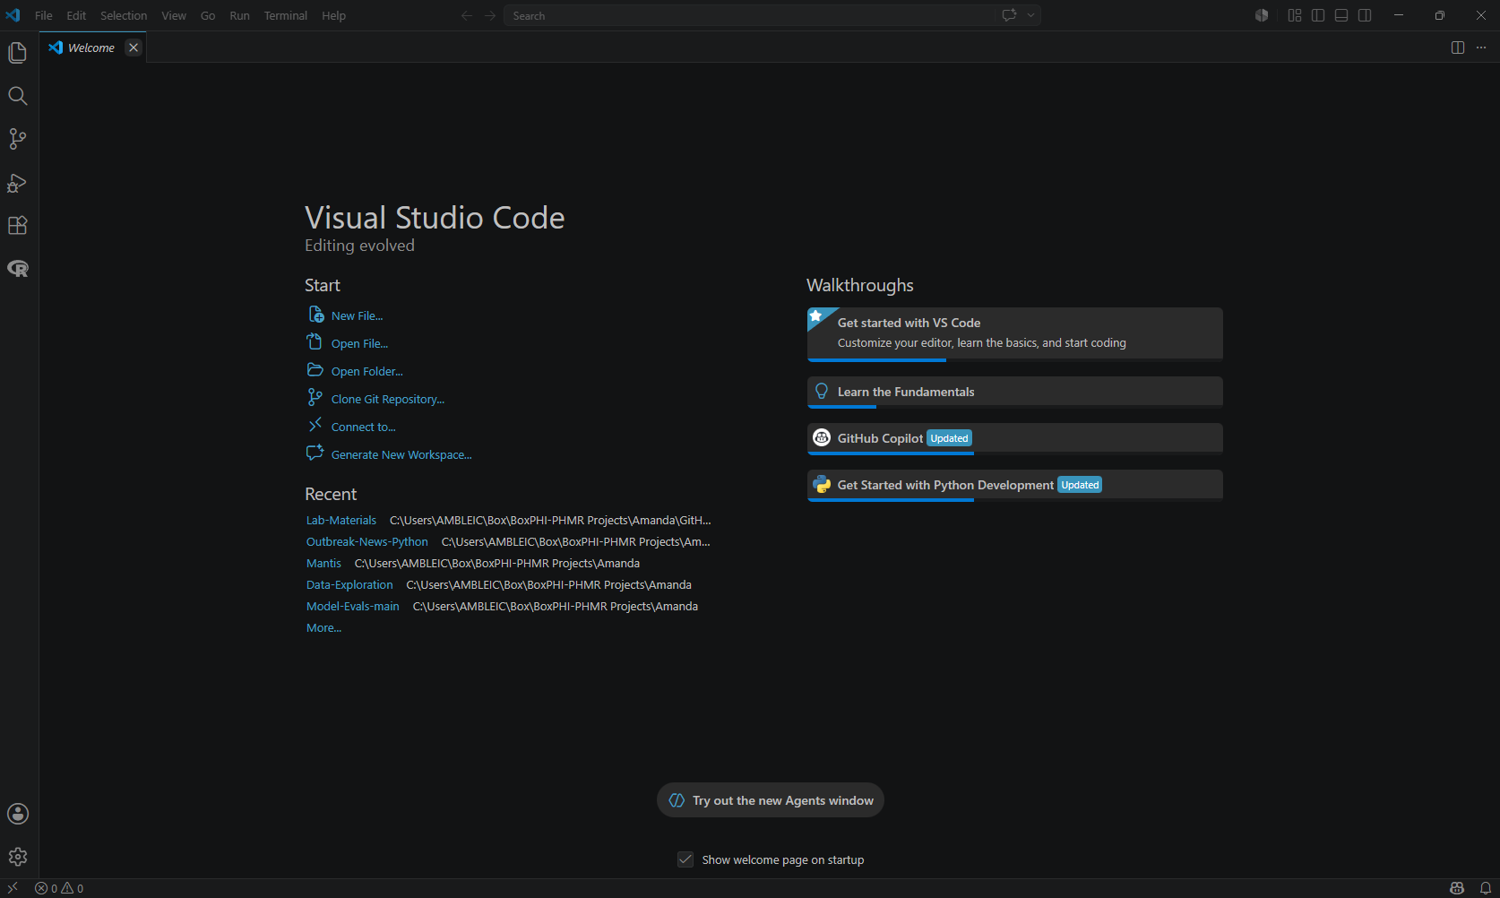
Visual Studio Code (VS Code)

Slide 7
VS Code Layout

Slide 8
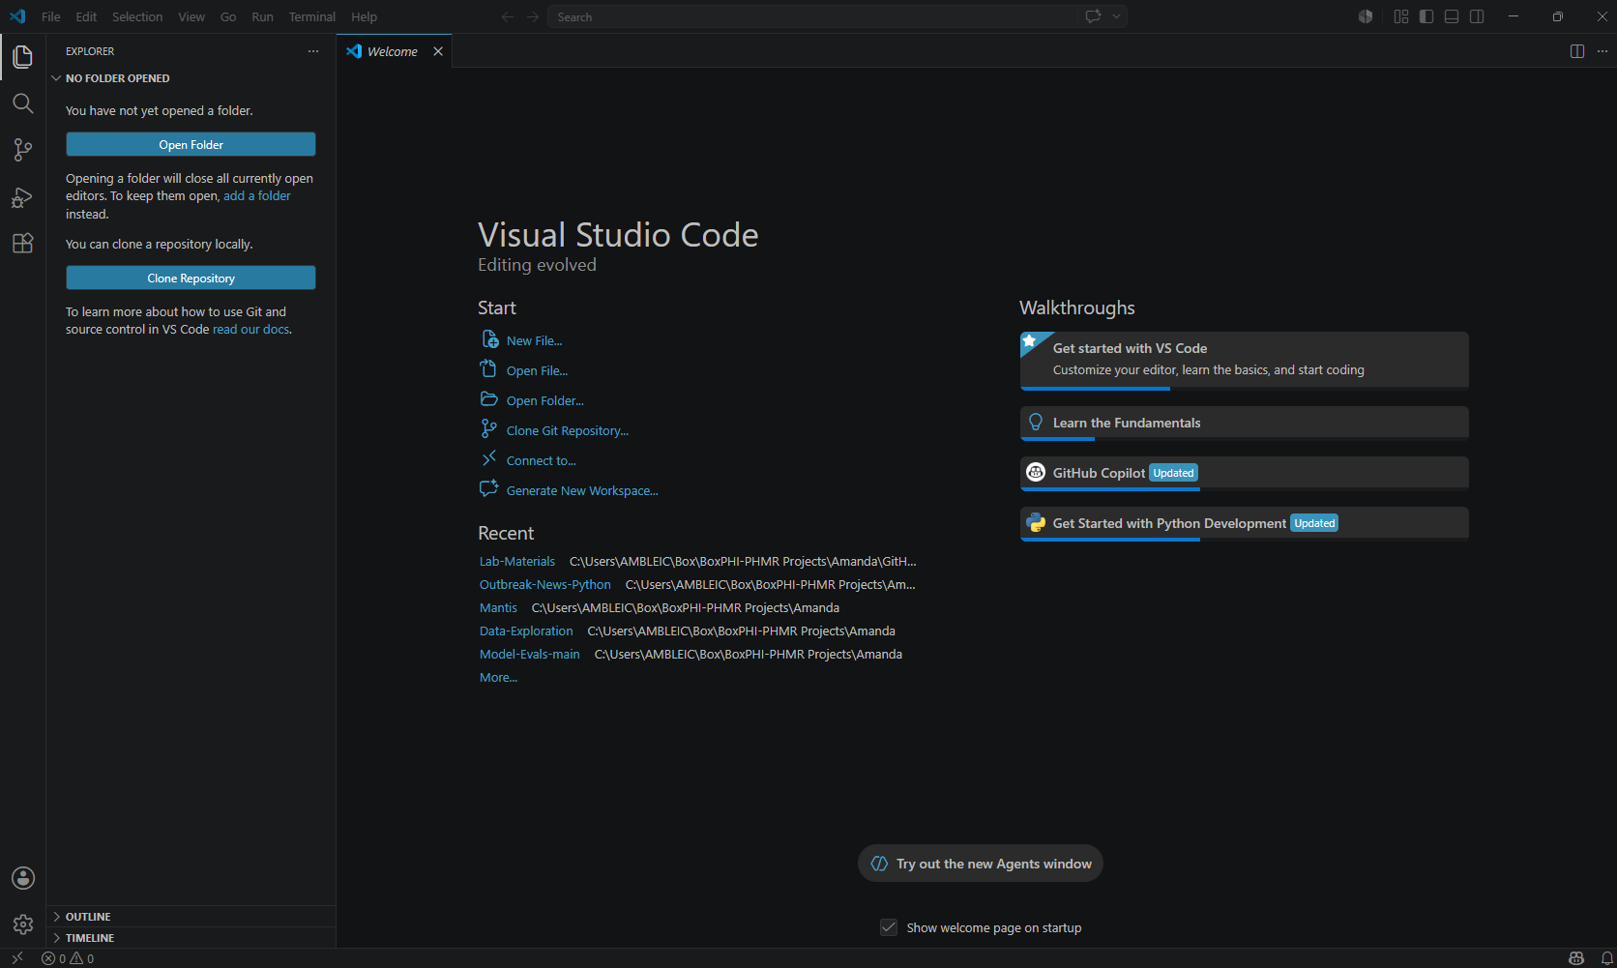
Activity Bar
Located on the far left-hand side. Lets you switch between views and gives you additional context-specific indicators, like the number of outgoing changes when Git is enabled. You can change the position of the Activity Bar.

Slide 9
Primary Side Bar
Contains different views like the Explorer to assist you while working on your project. Later slides will focus on how to set up the working directory here.

Slide 10
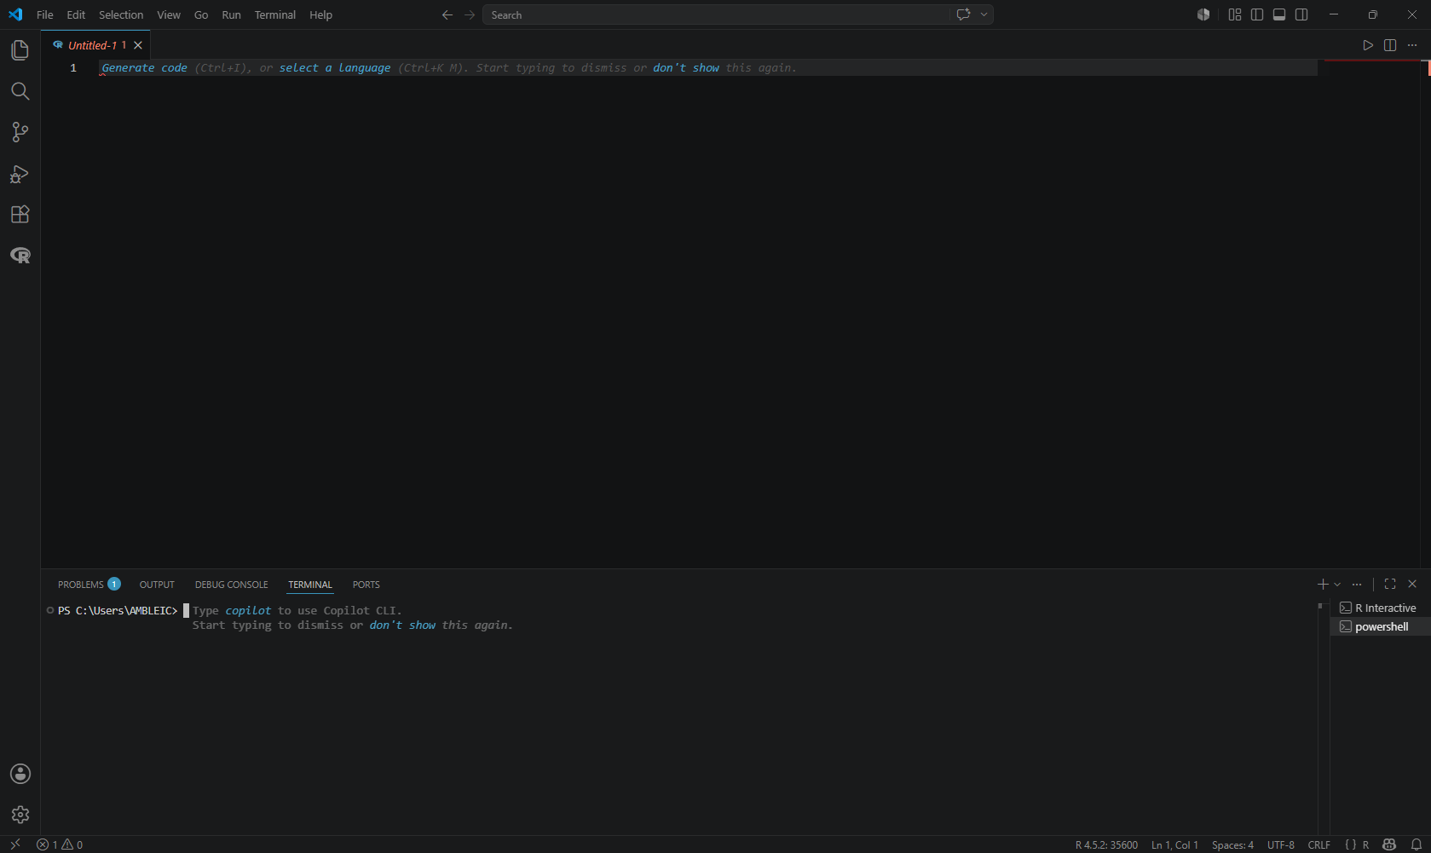
Editor
The main area to edit your files. You can open as many editors as you like side by side vertically and horizontally. To open the editor, click File, New File, and then the type of file (center menu will drop down). Later slides will cover how to open an R Script file.

Slide 11
Panel
An additional space for views below the editor region. By default, it contains output, debug information, errors and warnings, and an integrated terminal. The Panel can also be moved to the left or right for more vertical space. Later slides will cover how to open the R terminal.
If not visible when you first open VS Code, you can drag it upward.

Slide 12
Task 1: Installing the R Extension

Slide 13
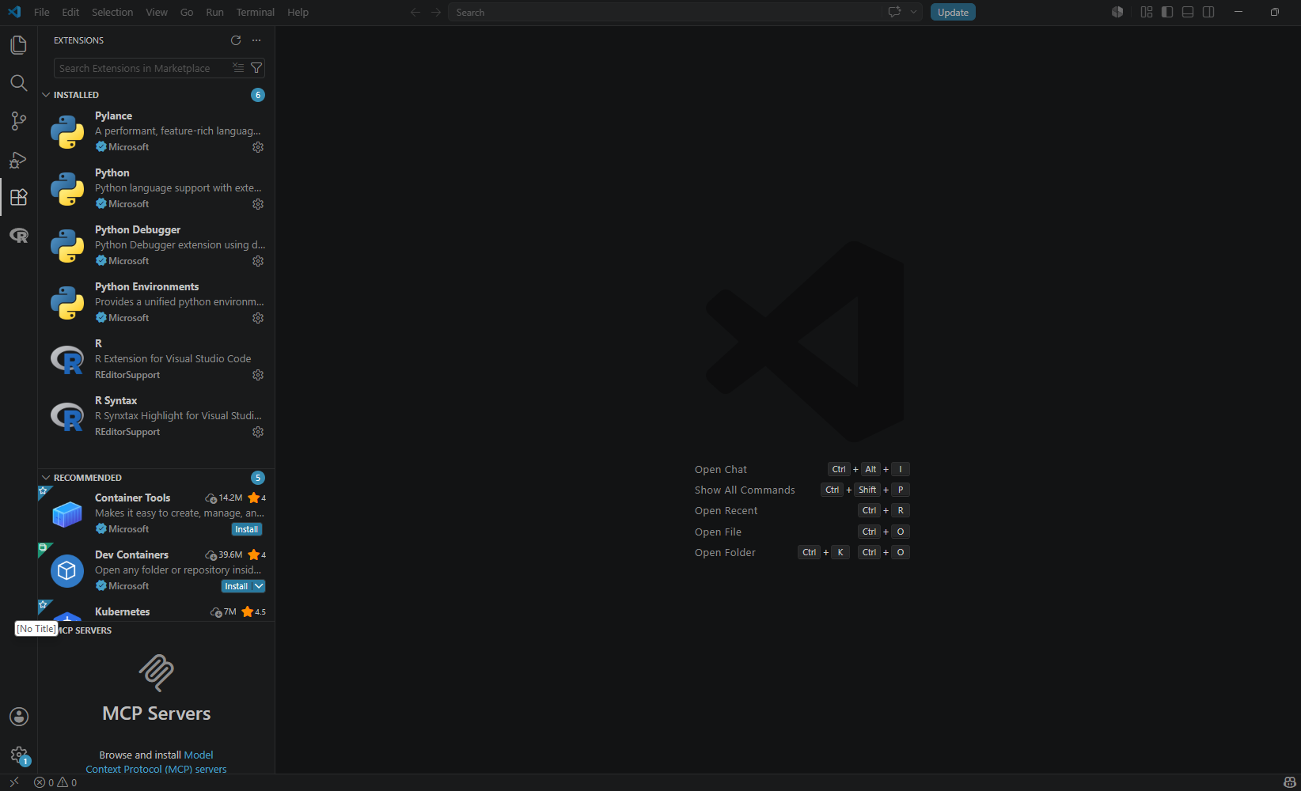
Extension Marketplace
We now need to install the R extension via VS Code. To bring up the Extensions view, either click on the Extensions icon in the Activity Bar on the side of VS Code or the View:
Extensions command (Ctrl+Shift+X).

Slide 14
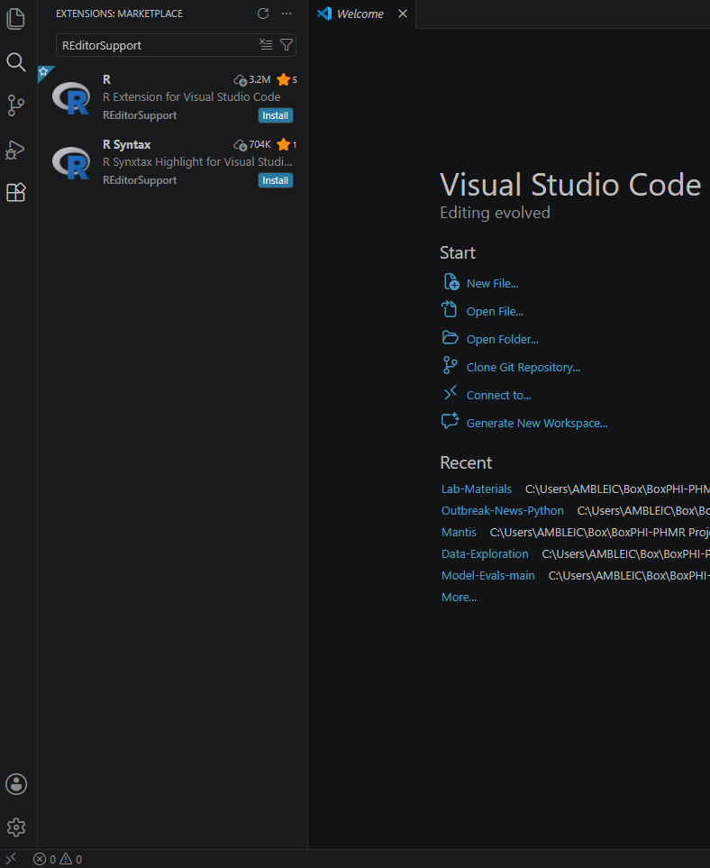
Step 1: Search for REditorSupport
After you have the Extensions Marketplace open, you will then want to search for REditorSupport. This will connect R and VS Code.
Step 2: Install R Extension
By this point, you should have R downloaded onto your local system. If you have not done so, please navigate to https://cran.r-project.org and download R. If you have R downloaded, all you need to do for this step is click the Install button for the R Extension.

Slide 15
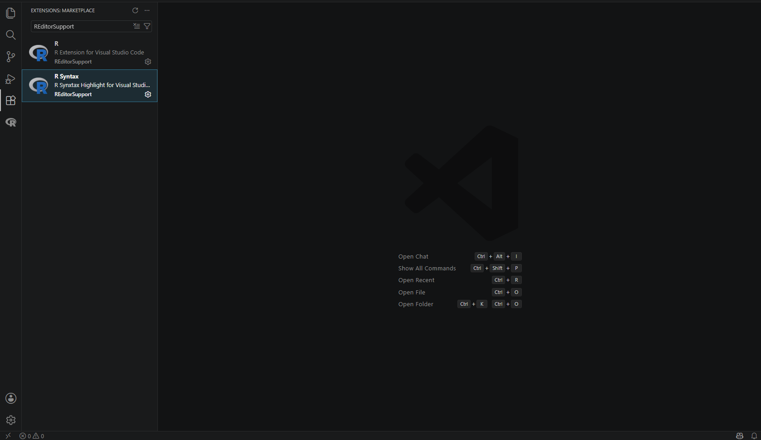
Once you have clicked Install on the R Extension option, the Install button should disappear for both the R and R Syntax extensions.

Slide 16
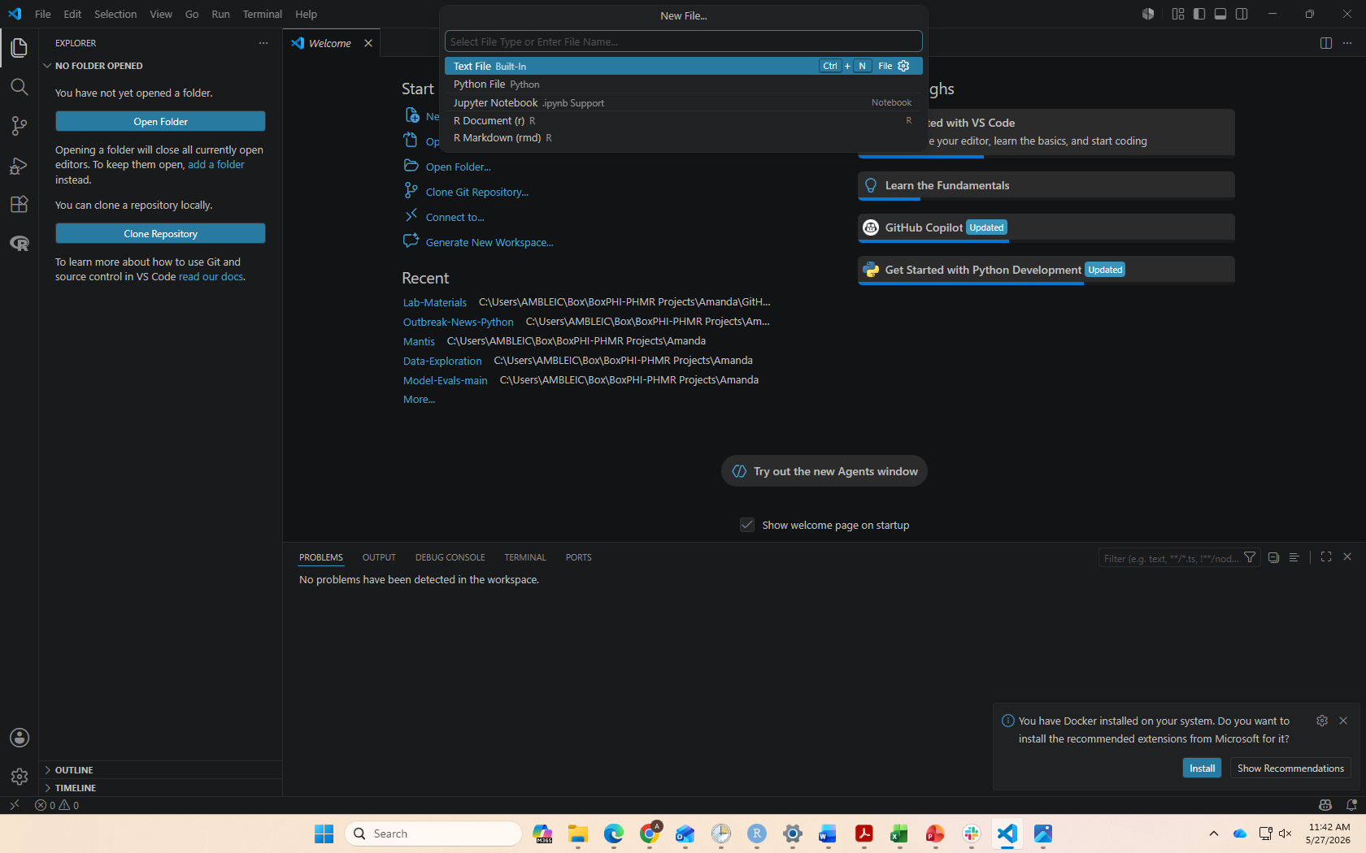
Opening an R Script
Step 1: Open an R Script
Press Ctrl + Shift + P (Windows) or Cmd + Shift + P (Mac) to open the Command Palette. Type R and select R: Create R File (or R Document (R), depending on your setup). This will open a new R script where you can write and run R code.

Slide 17
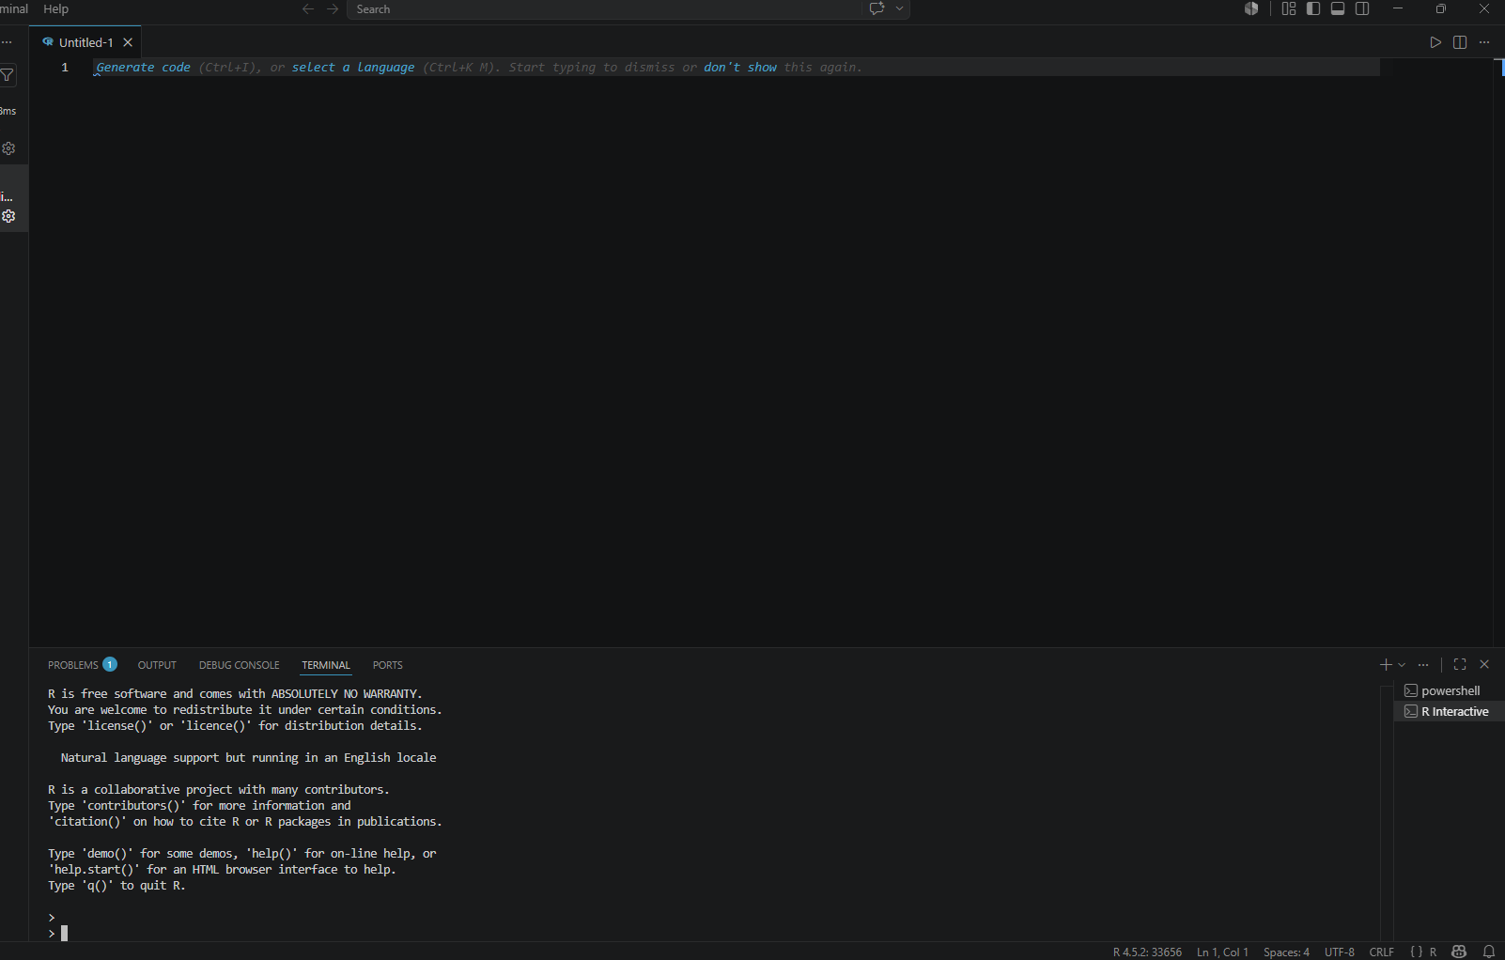
Step 2: Open the R Terminal
Press Ctrl + Enter to run a line of code, which opens the R terminal (i.e., where we can see any errors and the log of our code runs). Most of the work for this lab will happen within the R scripts, rather than the R terminal.

Slide 18
Task 2: GitHub Copilot Setup

Slide 19
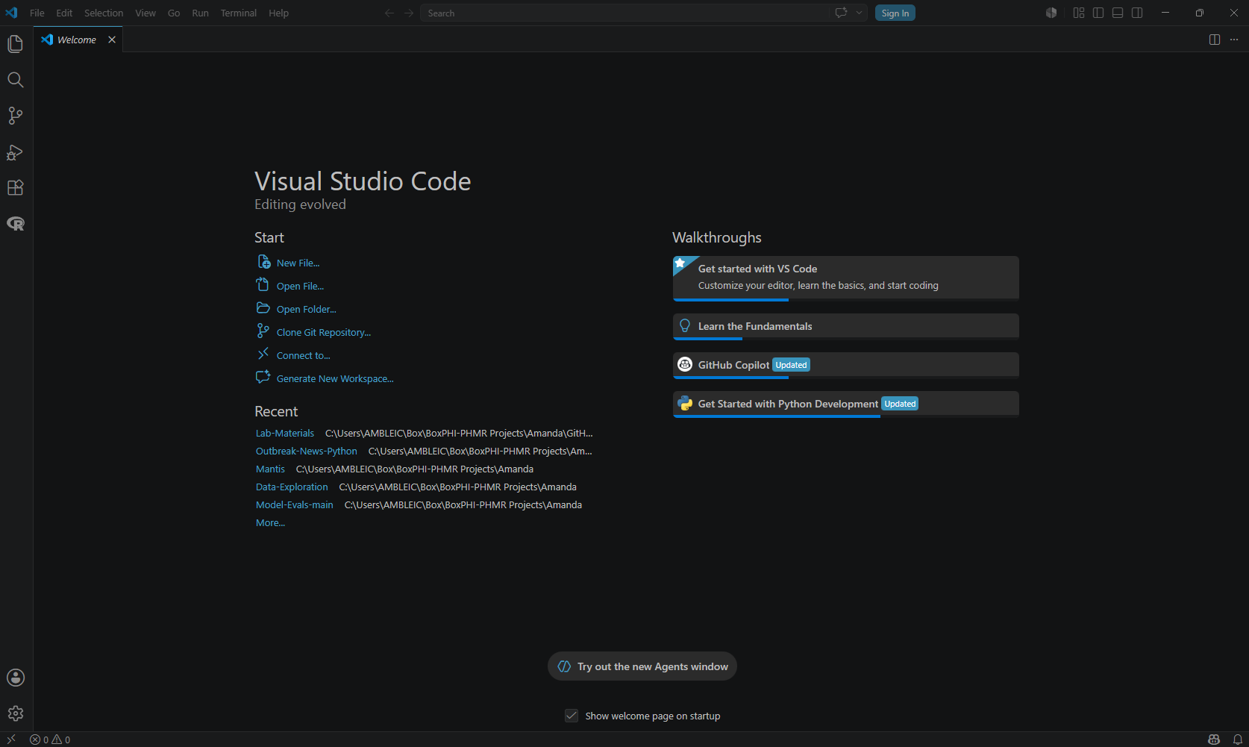
Step 1: GitHub Copilot
VS Code provides an integrated GitHub Copilot feature that can be used to aid with coding and other tasks. We will primarily be using this to help us develop and update our model pipeline. First, we must connect VS Code to our GitHub account. Click the GitHub Copilot icon in the bottom right of the VS Code interface to get started.

Slide 20
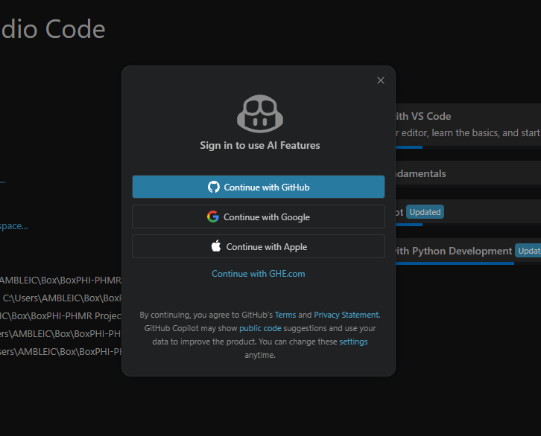
Step 2: Continue with GitHub
Next, click the “Continue with GitHub” option. This will open the GitHub login page and is where you will log into your GitHub account.

Slide 21
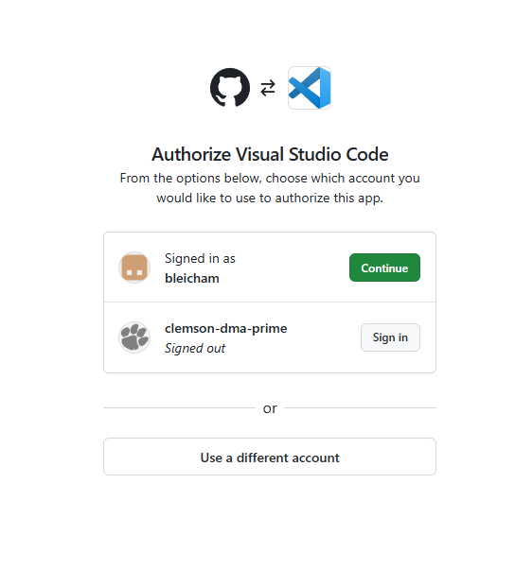
Step 3: Authorize VS Code
If you are already logged into your GitHub account, click “Continue”. Otherwise, log into your GitHub account and then authorize VS Code.

Slide 22
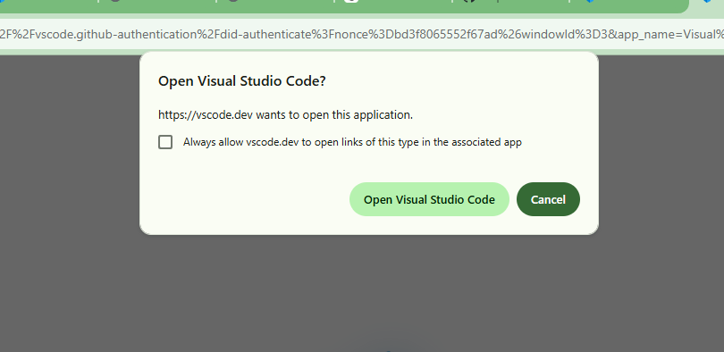
Step 4: Open VS Code
Once you have successfully authorized VS Code and/or logged into your GitHub account you should see the “Open Visual Studio Code” pop-up. Click “Open Visual Studio Code”.

Slide 23
GitHub Copilot Layout

Slide 24
Step 1: Opening the Chat
Next to the search bar there is a chat box icon with little stars by it. To open the chat sidebar, click the icon.

Slide 25
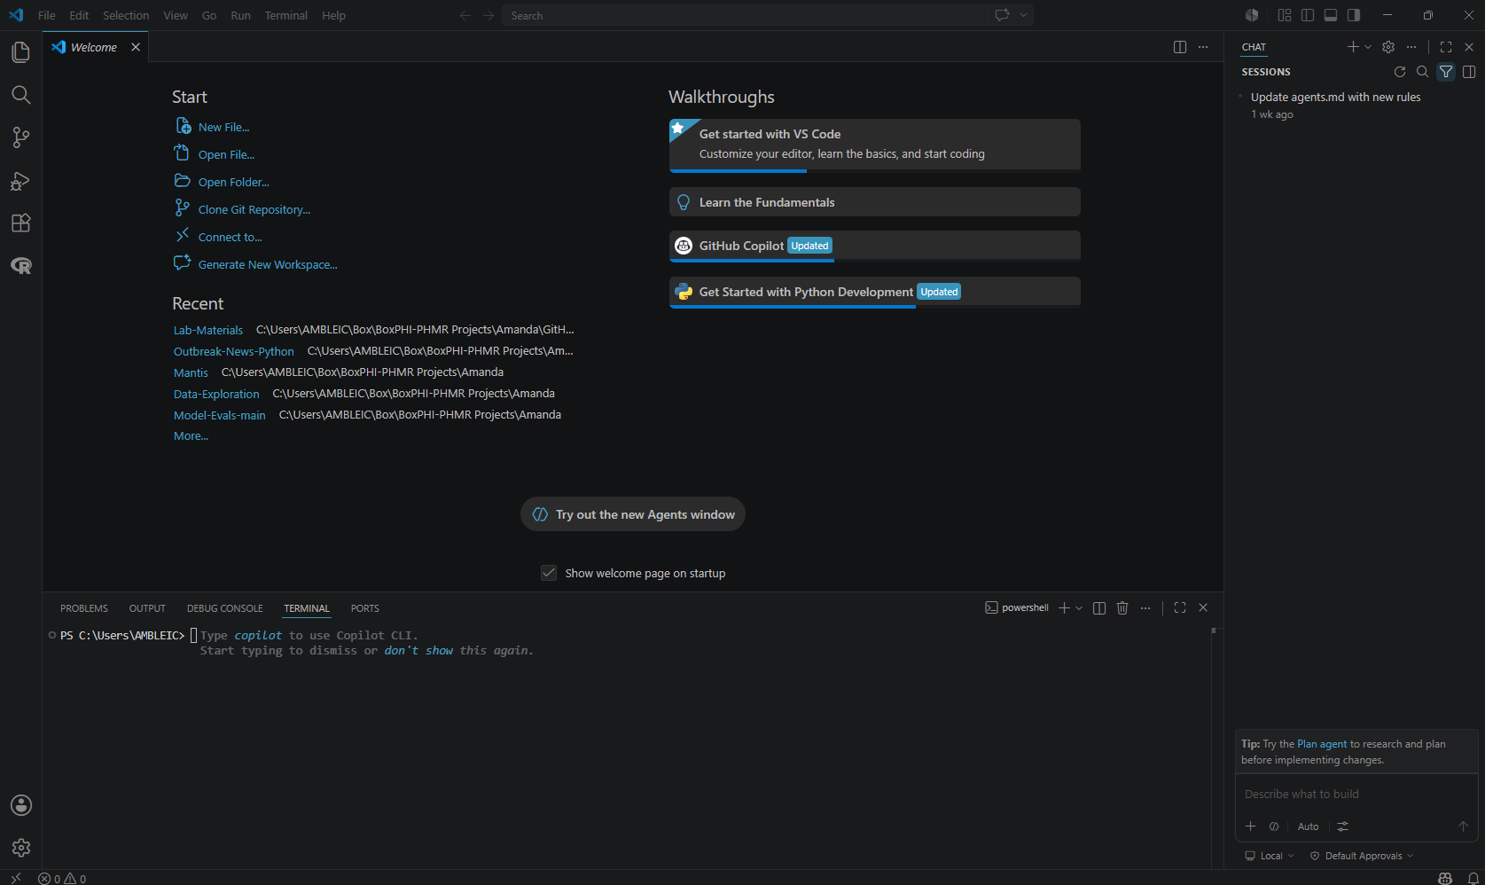
Secondary Side Bar
Opposite the Primary Side Bar. By default, contains the Chat view. Drag and drop views from the Primary Side Bar to the Secondary Side Bar to move them.
Primary Chat Box + Configuration
At the bottom of the sidebar, you will see a chatbot with lots of buttons under it. This is where we will set the primary configurations for our lab, and where you will interact with the AI.

Slide 26
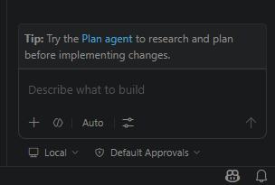
Step 2: Choosing an Agent Type
AI agents can operate locally or in the cloud and may function either interactively with user guidance or autonomously in the background. Choosing the appropriate setup depends on the task requirements and desired level of user involvement.
Local: Runs the agent interactively in the editor with full access to your workspace, tools, and models.
Copilot CLI: Runs in the background on your machine, optionally using Git worktrees for isolation.
Cloud: Runs remotely and integrates with GitHub pull requests for team collaboration.
Third-party: Uses the third-party agent harness and SDK from Anthropic and OpenAI to run either locally on your machine or in the cloud.
Want to learn more?
VS Code provides additional information about selecting AI types at:
https://code.visualstudio.com/docs/copilot/agents/overview
Notes:
Obtained From: https://code.visualstudio.com/docs/copilot/agents/overview

Slide 27
Step 3: Choosing an Agent
We can select the agent persona we want to use for our tasks. The selected option controls what tools the AI can use and how it completes the task at hand. The three built-in agents are:
Agent: autonomously plans and implements changes across files, runs terminal commands, and invokes tools.
Plan: creates a structured, step-by-step implementation plan before writing any code. Hands the plan off to an implementation agent when it looks right.
Ask: answers questions about coding concepts, your codebase, or VS Code itself without making file changes.
We will be using a mix of all three types throughout the lab. We will start with the ‘Agent’ option.
Want to learn more?
VS Code provides additional information about choosing agents at:
https://code.visualstudio.com/docs/copilot/agents/overview#_choose-an-agent
Notes:
Obtained From: https://code.visualstudio.com/docs/copilot/agents/overview#_choose-an-agent

Slide 28
Step 4: AI Language Models in VS Code
There are a multitude of built-in models available via GitHub Copilot to choose from.
Each model has its own strengths and weaknesses, and choosing the right model is an important piece of working with AI. For example, if your task is simple edits or questions, you can use a “fast” model. For more complex tasks, such as refactoring or multi-step tasks, a reasoning model may be better.
For our lab, we will stick with “Auto” model selection. When “Auto” is selected, VS Code determines a task’s complexity and real-time model availability to select the optimal model.
Want to learn more?
VS Code provides additional information about AI language models in VS Code at:
https://code.visualstudio.com/docs/copilot/customization/language-models
Notes:
Obtained From: https://code.visualstudio.com/docs/copilot/customization/language-models

Slide 29
Step 5: Use Tools with Agents
Tools provide agents specialized functionality for completing specific tasks like searching code, running commands, fetching web content, or invoking APIs.
In VS Code, the agent automatically determines which tools to use from the enabled tools based on your prompt and the context of your request. The agent autonomously chooses and invokes relevant tools as needed to accomplish the task.
For the lab, we will not change any settings related to tools configuration and use the built-in settings.
Want to learn more?
VS Code provides additional information about using tools with agents at:
https://code.visualstudio.com/docs/copilot/agents/agent-tools
Notes:
Obtained From: https://code.visualstudio.com/docs/copilot/agents/agent-tools

Slide 30
Step 6: Adding Context to Your Prompts
Providing the right context helps the AI generate more relevant and accurate responses.
Implicit context: VS Code automatically includes the active file, your current selection, and the file name as context. When you use agents, the agent decides autonomously if additional context is needed.
#-mentions: type # in the chat input to explicitly reference files (#file), folders, symbols, your codebase (#codebase), terminal output (#terminalSelection), or tools like #fetch.
@-mentions: type @ to invoke specialized chat participants like @vscode or @terminal, each optimized for their respective domain.
Vision: attach images, such as screenshots or UI mockups, as context for your prompt.
Want to learn more?
VS Code provides additional information about managing context for AI at:
https://code.visualstudio.com/docs/copilot/chat/copilot-chat-context
Notes:
Obtained From: https://code.visualstudio.com/docs/copilot/chat/copilot-chat

Slide 31
Step 7: Writing the Prompt & Sending
After setting up the AI configuration, you can now interact with your agent.
Once you have typed your message and attached any necessary context, click the up arrow to send the message.
Want to learn more?
VS Code provides additional information about GitHub Copilot at:
https://code.visualstudio.com/docs/copilot/overview
Notes:
Obtained From: https://code.visualstudio.com/docs/copilot/chat/copilot-chat

Slide 32
Task 3: Connecting GitHub & VS Code

Slide 33
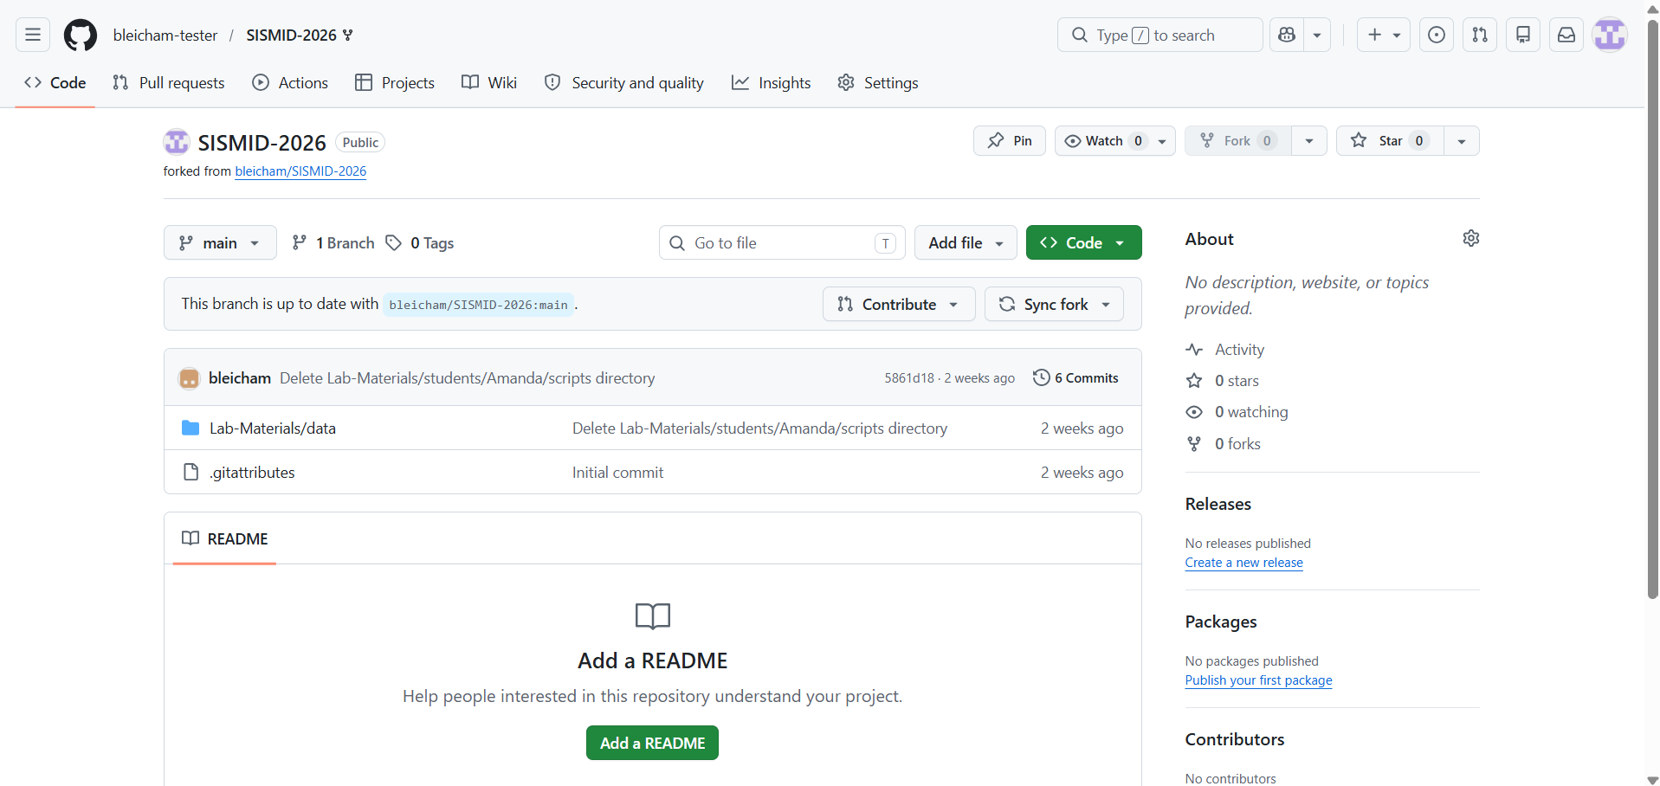
Step 1: Clicking Code
We are going to clone our fork in VS Code. This will allow us to easily make changes locally and then “push” to GitHub in later steps. First, we need to obtain the HTTPS URL for our GitHub fork. To do so, we first need to click the green code button.

Slide 34
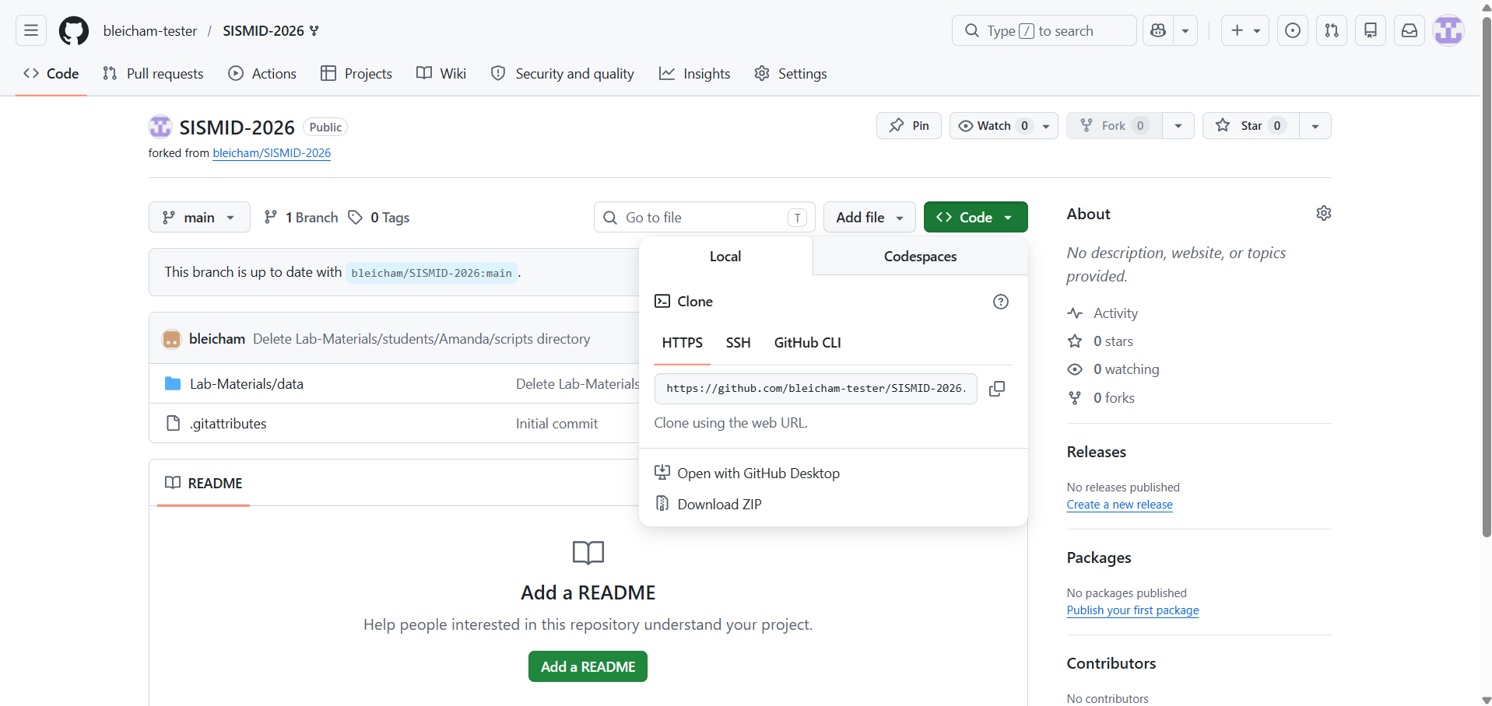
Step 2: Copy the HTTPS URL
Next, we will want to copy the HTTPS URL. This will be used within VS Code to connect it to our GitHub fork. To copy, click the two overlapping squares icon.

Slide 35
Now back to VS Code…

Slide 36
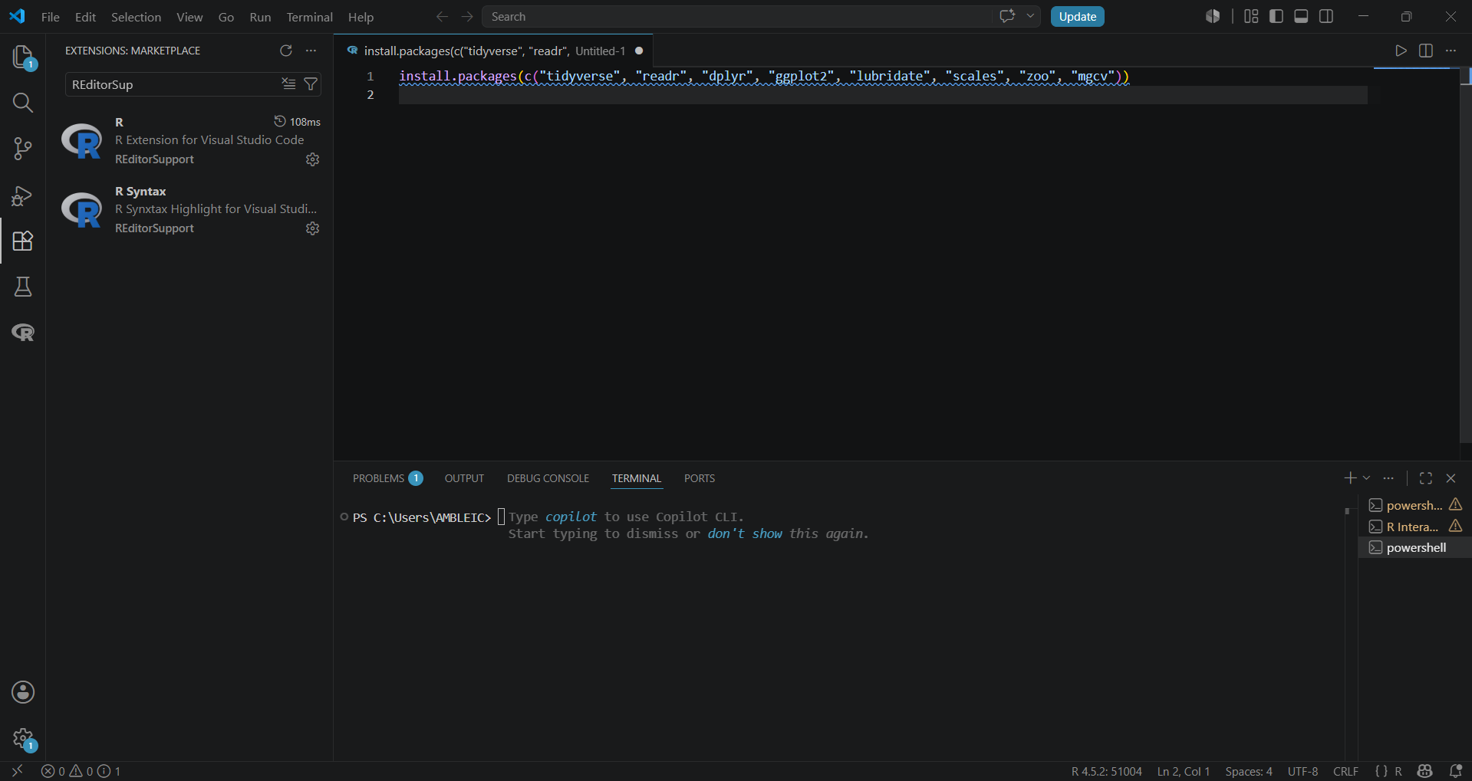
Step 3: Checking for Git
We now need to make sure Git is loaded in VS Code. In the terminal, first type: git --version
If you see a version number, skip to Step 4; otherwise, please refer to the Helper PPT Downloading Git PPT to download Git. Once downloaded, please repeat this step.

Slide 37
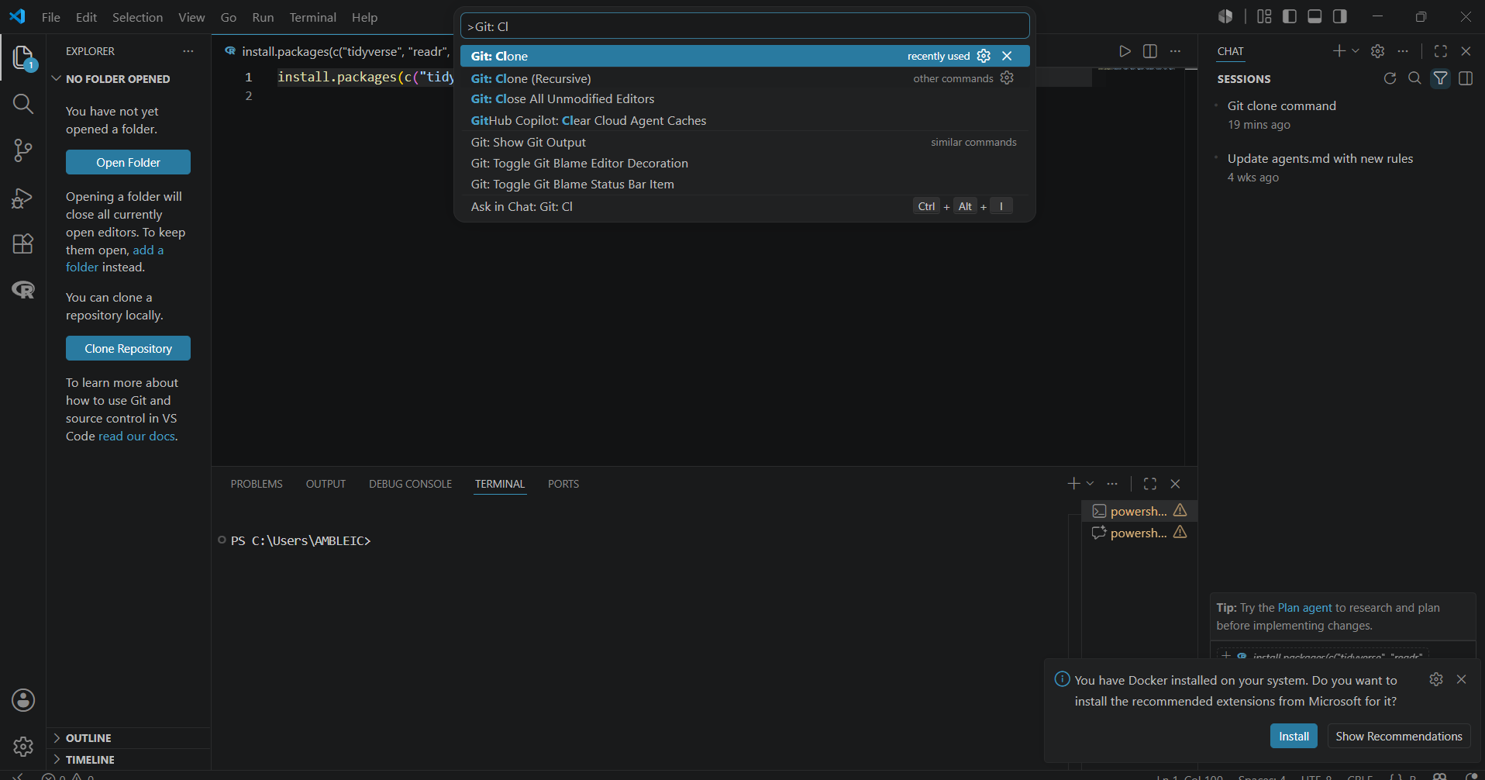
Step 4: Cloning the Repo
To begin the process of cloning the repo, first click: Ctrl + Shift + P
to open the command search at the top of the page. You can also click View (top of page) and then select Command Palette to open the search. Then type and click Git: Clone

Slide 38
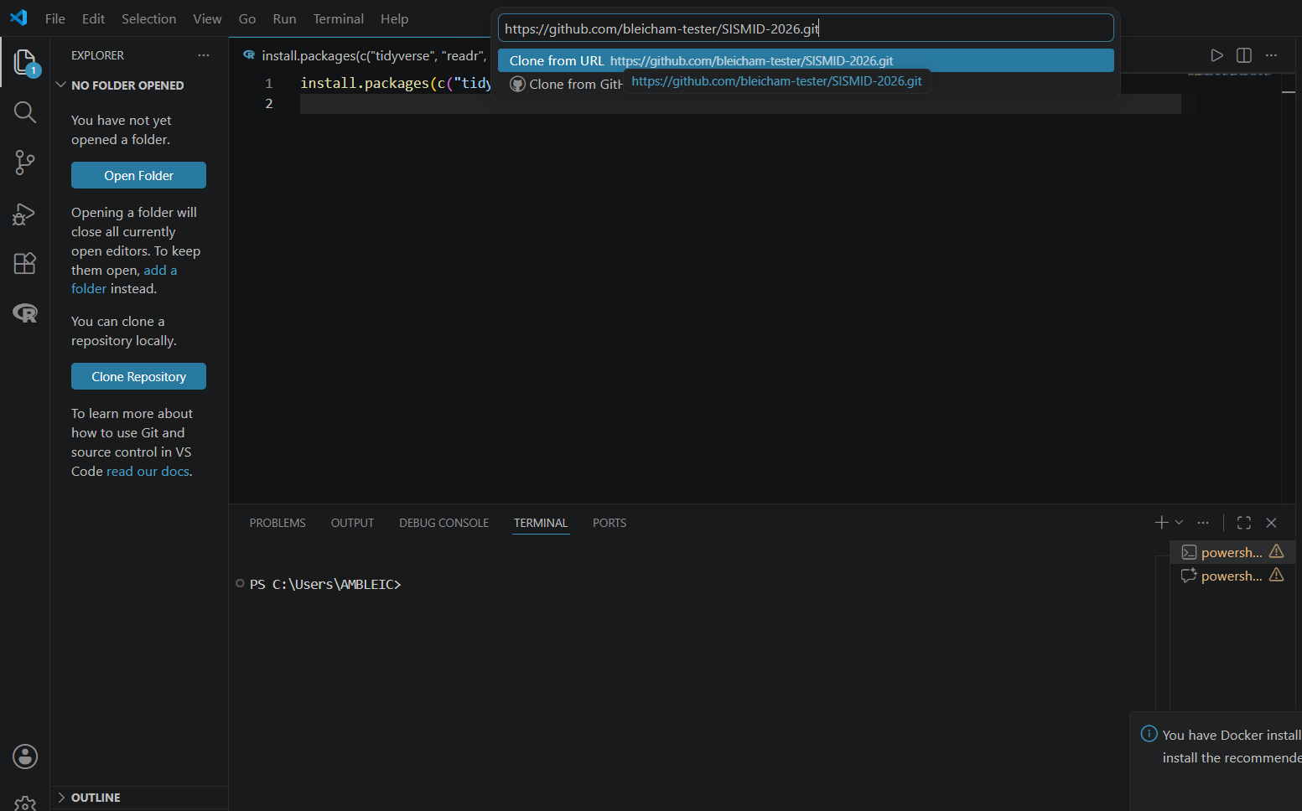
Step 4.1: Cloning the Repo
Next, copy and paste in the HTTPS URL of your GitHub fork into the search bar (Hint: This is what we copied in Step 2). You should also see a prompt asking for a GitHub HTTPS URL.
You may be prompted to log into GitHub at this step. If there are any issues with doing so, please let one of us know.

Slide 39
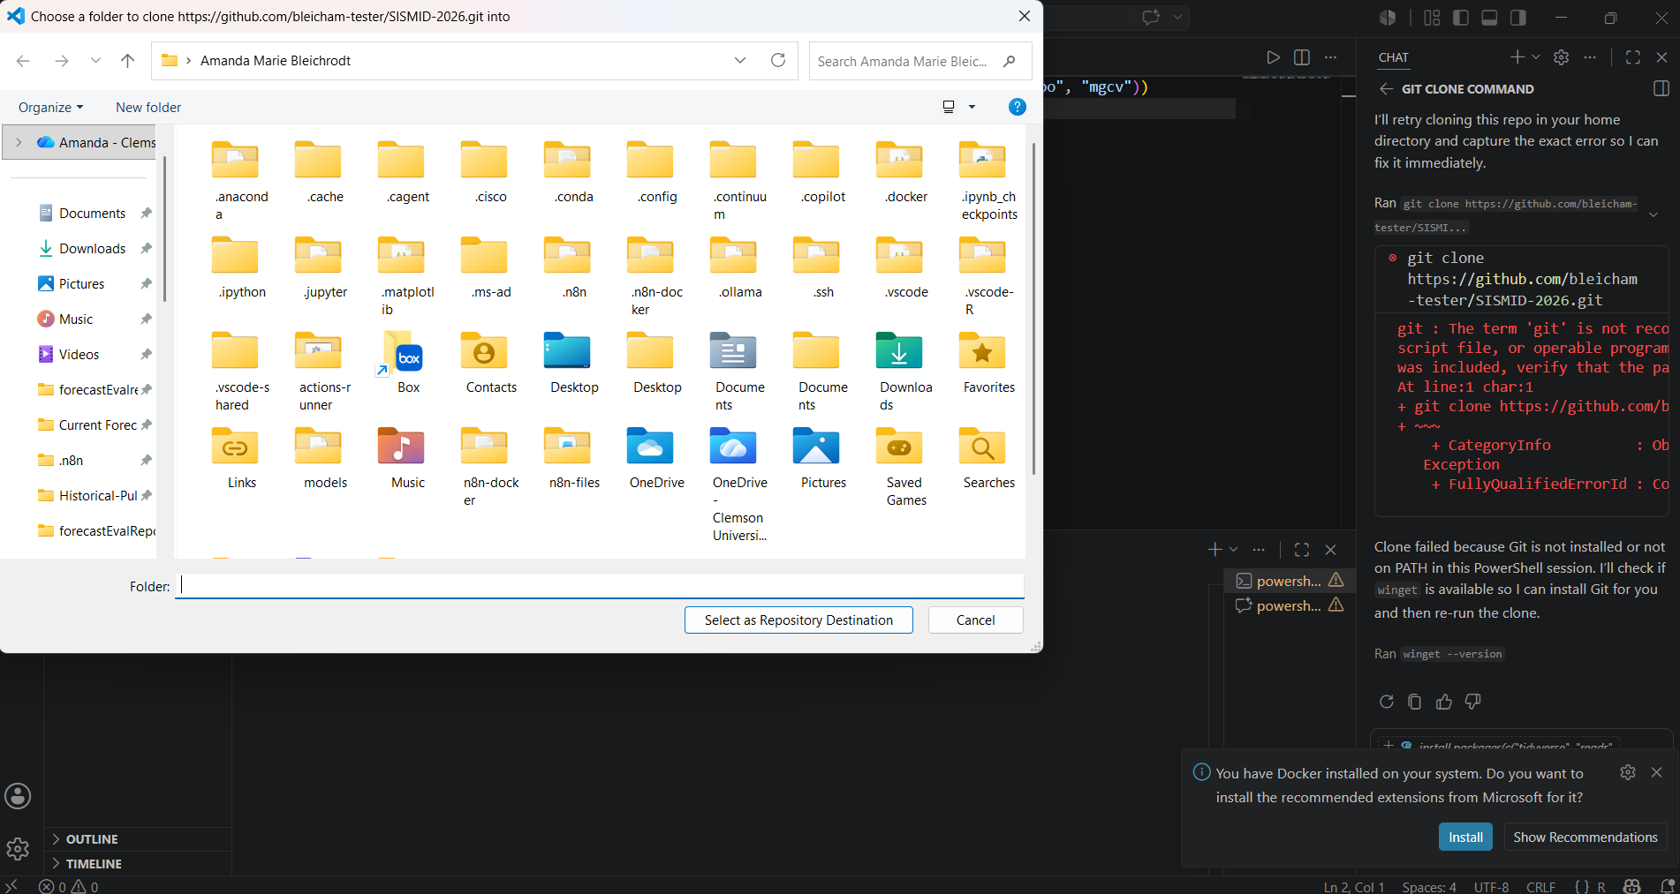
Step 5: Saving the Clone
After copy-and-pasting the HTTPS URL, you should see your folder directory. This is where you need to choose a folder to save your GitHub fork into. It will act as the local intermediary between VS Code and what you have on GitHub. We will talk about the structure of this folder in a later step; for now, you just need to select a place to save it.

Slide 40
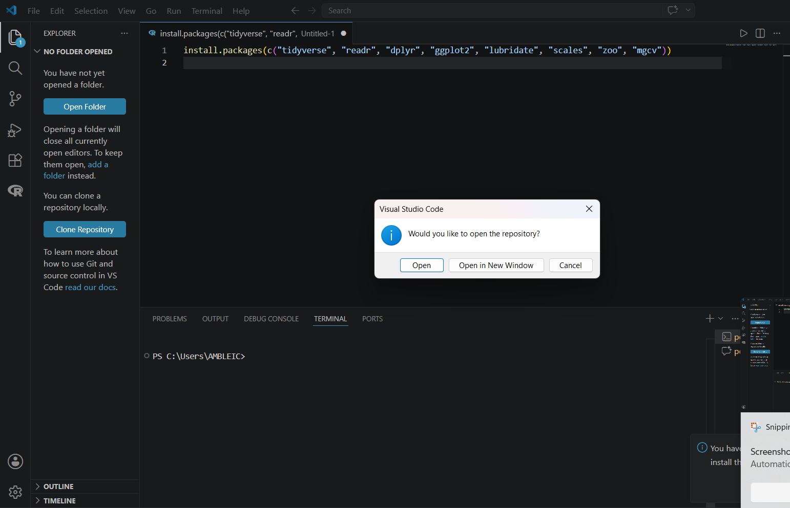
Step 6: Opening the Repository
After choosing a folder to save the local version of the repository, VS Code will prompt you to open it. Here, you want to click Open. This will ensure all your working directories are set up correctly and get you ready for the remainder of the lab.

Slide 41
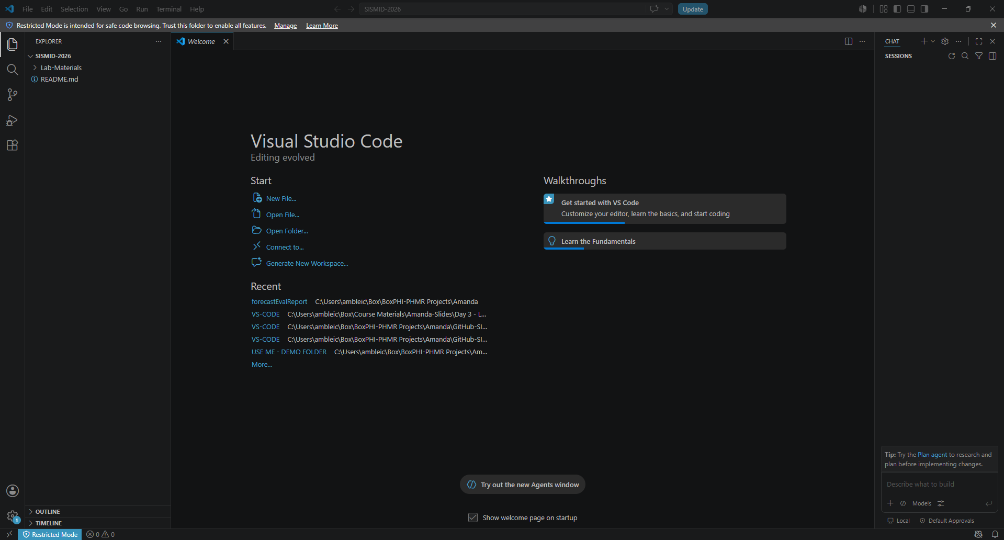
You should now see the folder structure of your GitHub repository in the Explorer tab of VS Code. If you do not or run into any errors, please let us know!

Slide 42
If after cloning (copying) the GitHub repository you are in ‘Restricted Mode’, we will need to indicate that we trust the files so we can access all VS Code features. To start this process, first click Restricted Mode.

Slide 43
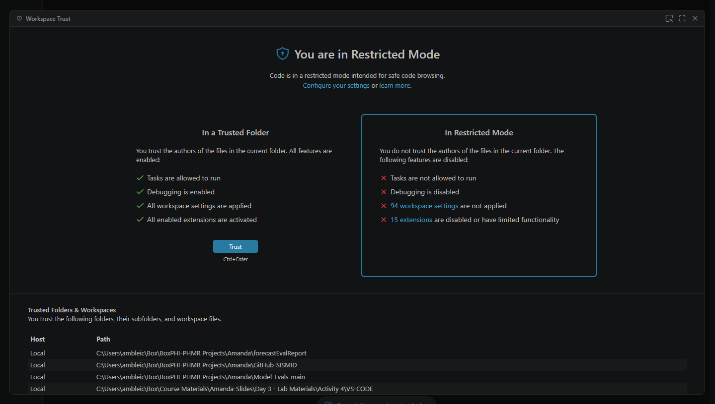
Next, click Trust and close out the pop-up.

Slide 44
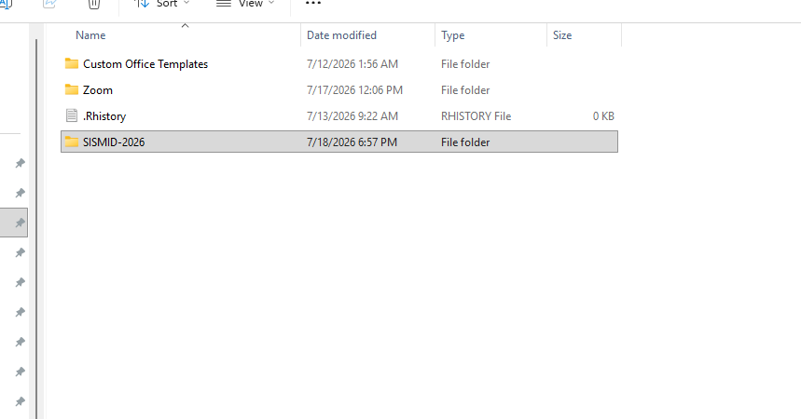
Task 4: Preparing the Working Directory
Step 1: Navigating to Local GitHub
Now that we have cloned our fork (copied the GitHub fork to our computer), we need to do some initial setup. This will come into play when we upload our results to GitHub. Click on the downloaded folder.

Slide 45
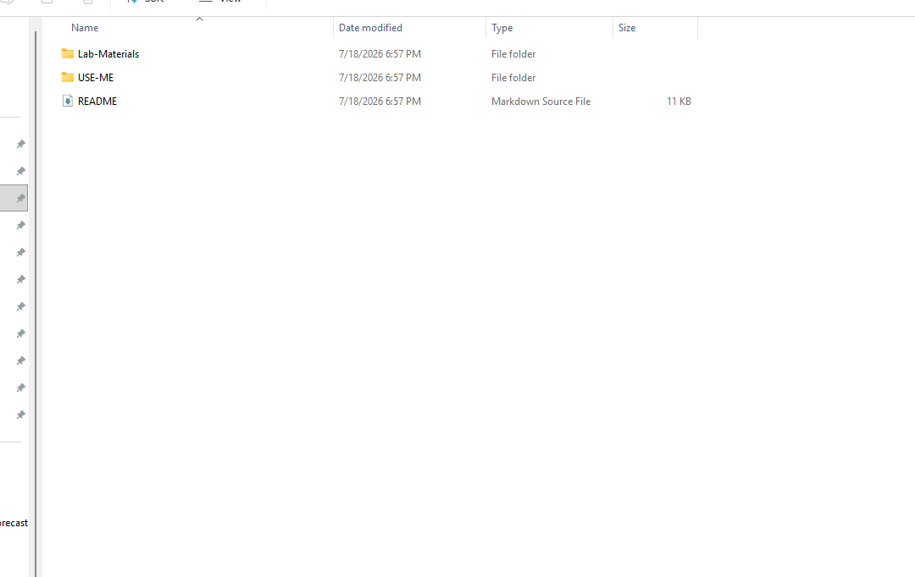
Step 2: Open the USE-ME folder
As discussed before, the USE-ME folder will be where we save our files. However, prior to doing so we need to create our named folder. First, click on USE-ME to open the folder.

Slide 46
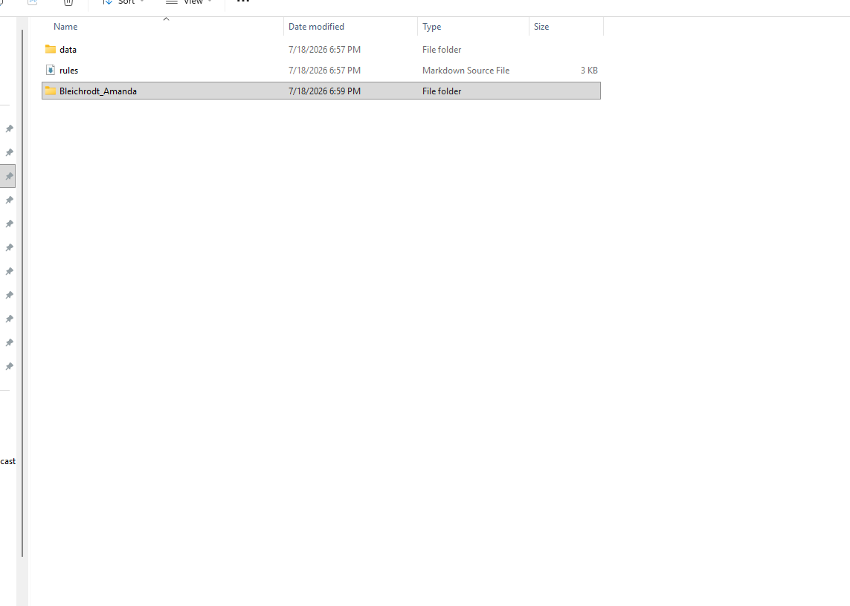
Step 3: Creating the named folder
Within the USE-ME folder, create a folder with your name as the label (or meaningful label) and move the data folder and rules.md within your newly created folder.

Slide 47
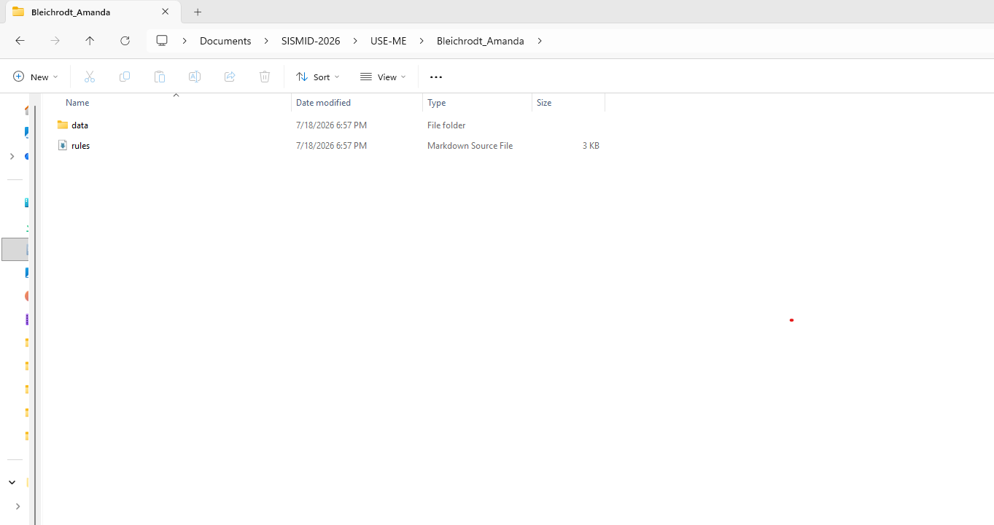
Step 4: Folder Structure
Your initial folder structure should look as follows (see image). As we move through the lab, this folder will continue to grow.

Slide 48
Task 5: Setting the Working Directory in VS Code

Slide 49
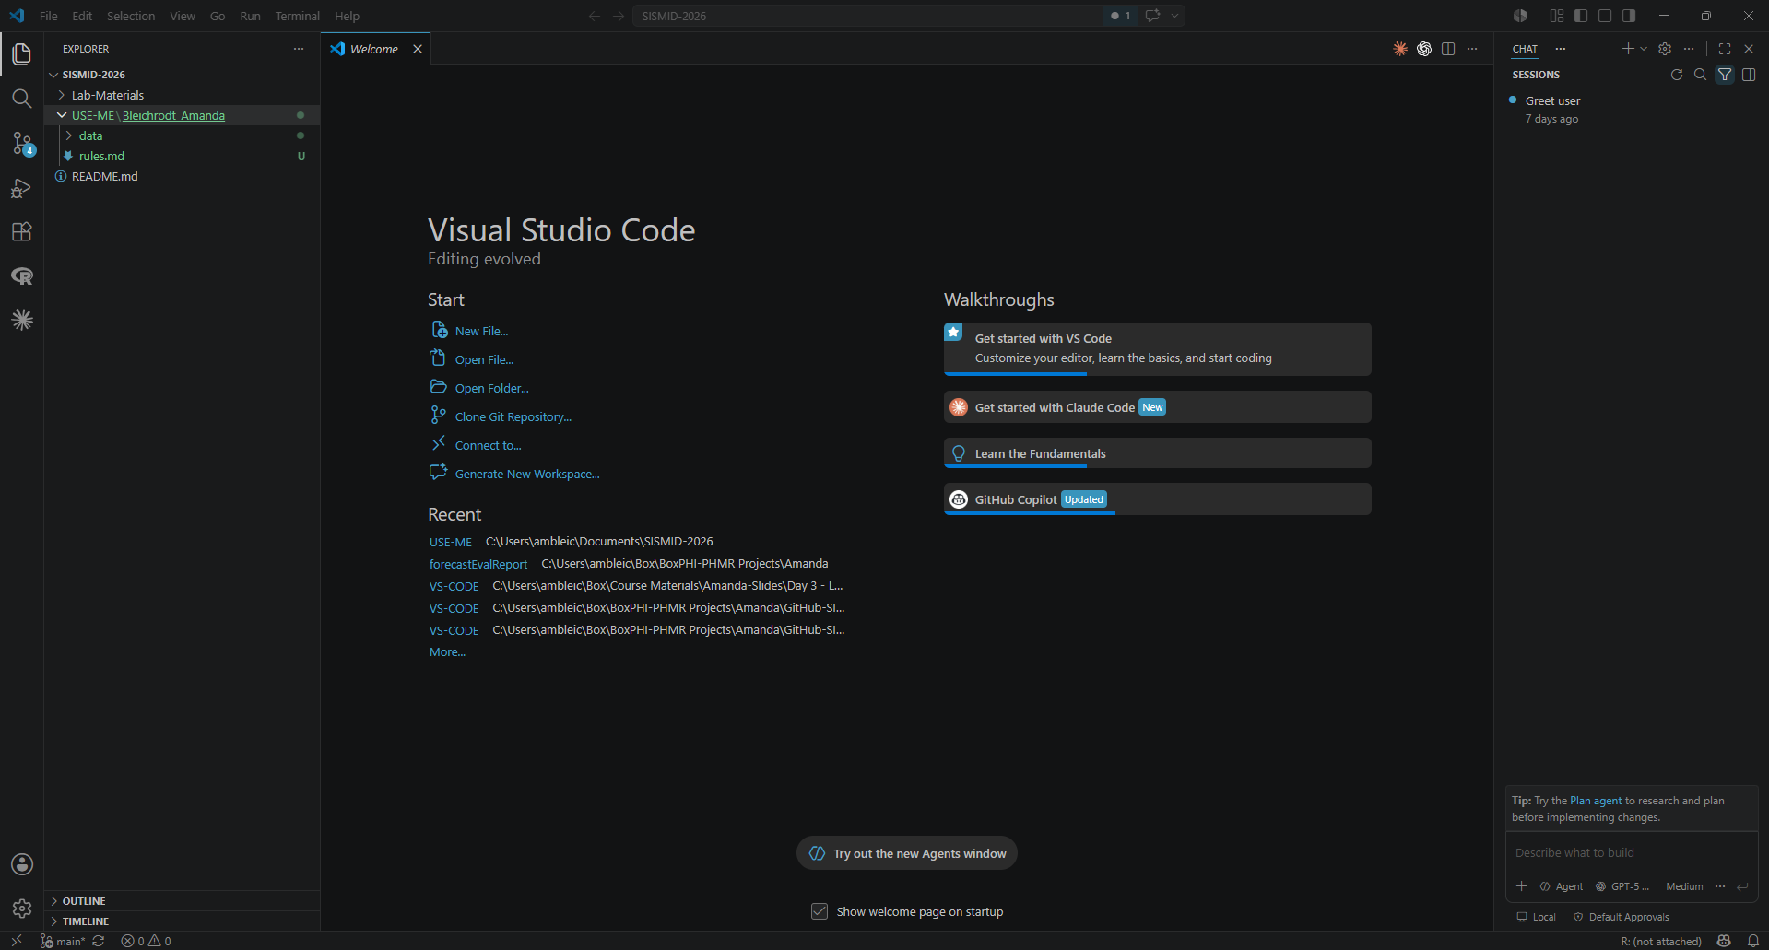
Step 1: Closing the Directory
To start the process of changing the working directory, we first need to close out the current one (i.e., essentially start fresh). To do so, first click File in the upper left corner. Then, click Close Folder.

Slide 50
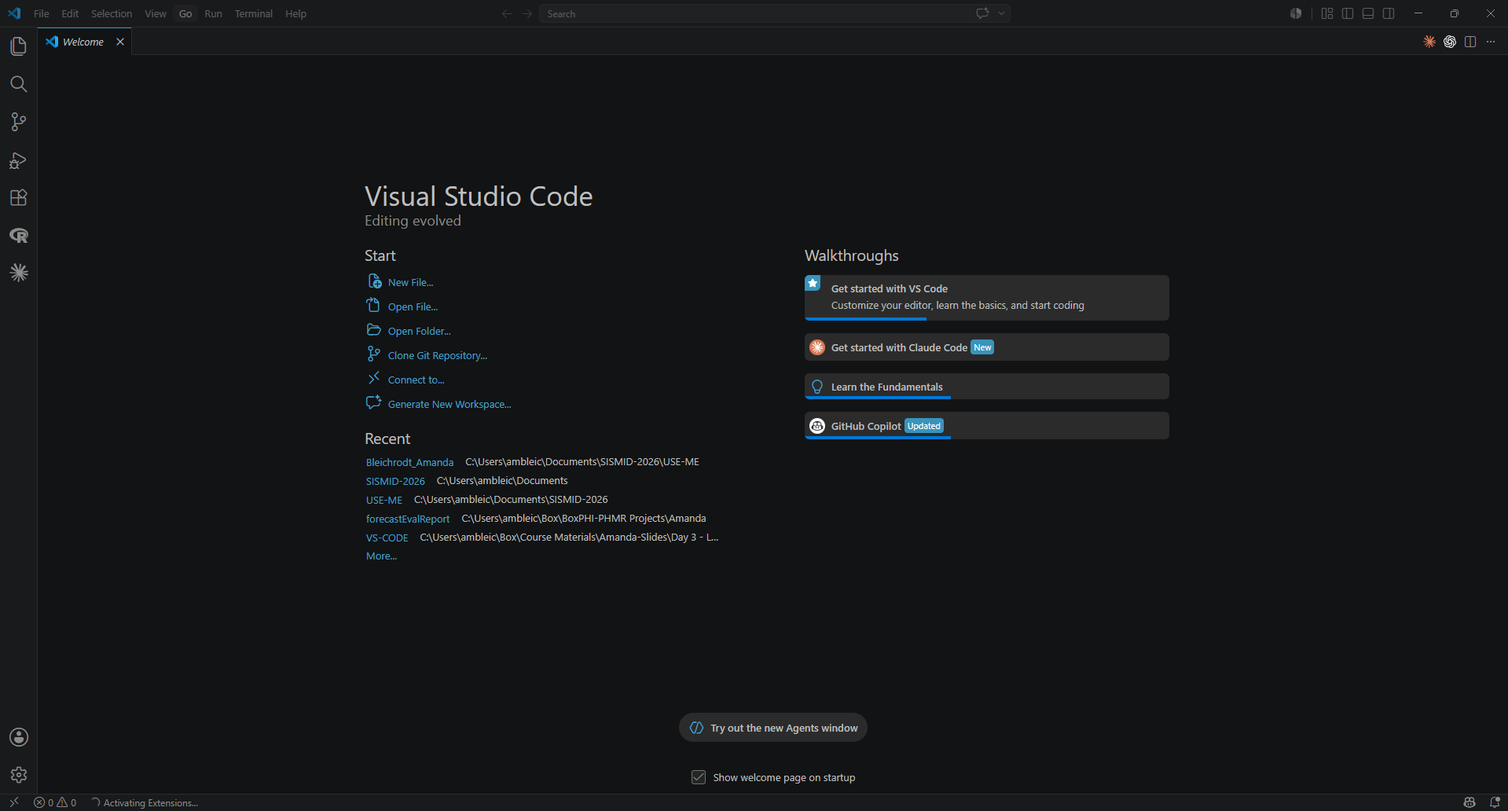
Step 2: Opening the Directory
Now, we must open the new directory (i.e., folder). First, click File in the upper left corner. Then, click Open Folder.

Slide 51
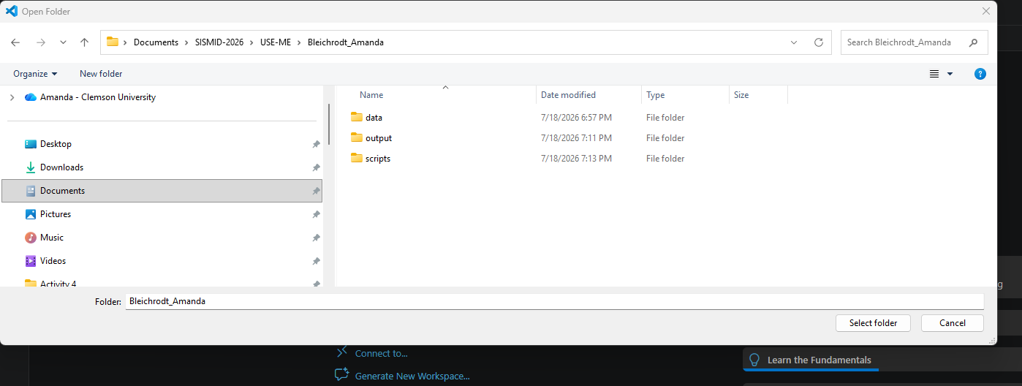
Step 3: Selecting Your Named Folder
As we are primarily working out of our newly created named folder, we want to select that as our working directory. First, navigate to where you saved the GitHub repository and created the named folder. Next, open the named folder and click Select folder.

Slide 52
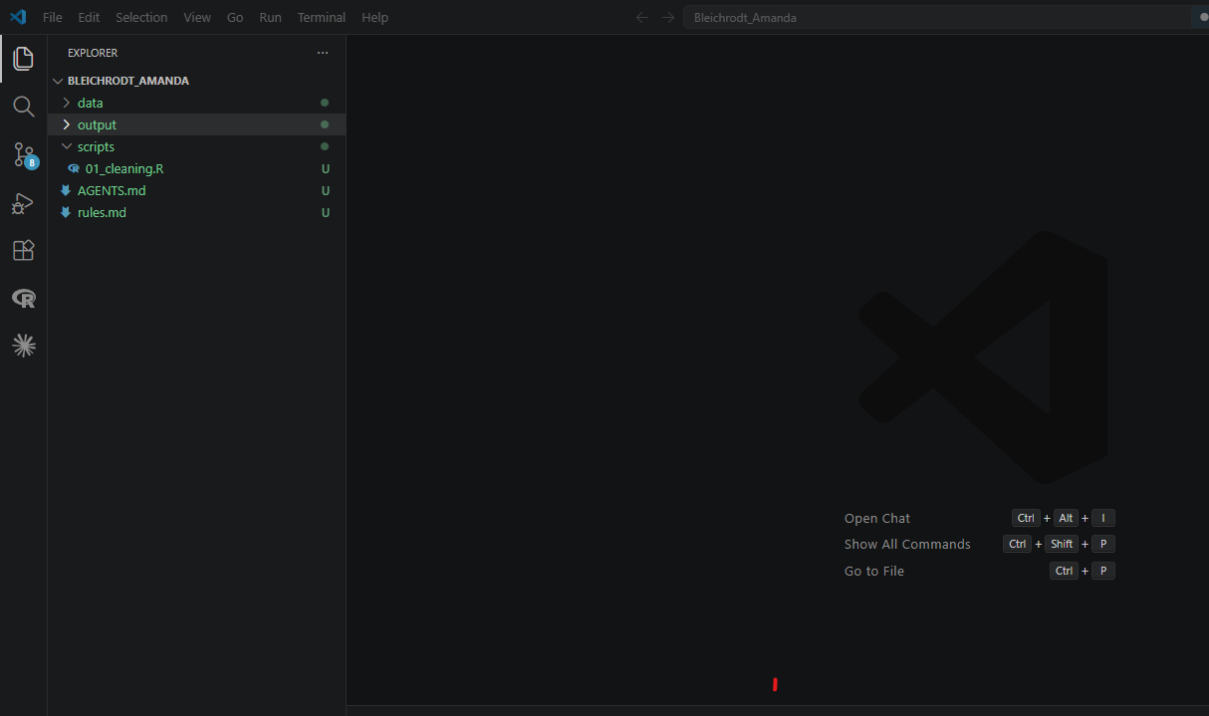

Step 4: VS Code
Once you have navigated back to VS Code, you should now see the named folder in the Explorer menu.

